Slide 1
Statistical Inference

Slide 2
Statistical Inference
Statistical inference focuses on drawing conclusions about populations from samples.
Statistical inference includes estimation of population parameters and hypothesis testing, which involves drawing conclusions about the value of the parameters of one or more populations.

Slide 3
Hypothesis Testing
Hypothesis testing involves drawing inferences about two contrasting propositions (each called a hypothesis) relating to the value of one or more population parameters.
H₀: Null hypothesis: describes an existing theory
H₁: Alternative hypothesis: the complement of H₀
Using sample data, we either:
- reject H₀ and conclude the sample data provides
sufficient evidence to support H_{1,} or
- fail to reject H₀ and conclude the sample data
does not support H_{1.}

Slide 4
Example 1: A Legal Analogy for Hypothesis Testing
In the U.S. legal system, a defendant is innocent until proven guilty.
H₀: Innocent
H₁: Guilty
If evidence (sample data) strongly indicates the defendant is guilty, then we reject H_{0.}
Note that we have not proven guilt or innocence!

Slide 5
Hypothesis Testing Procedure
Steps in conducting a hypothesis test:
Identify the population parameter and formulate the hypotheses to test.
Select a level of significance (the risk of drawing an incorrect conclusion).
Determine the decision rule on which to base a conclusion.
Collect data and calculate a test statistic.
Apply the decision rule and draw a conclusion.

Slide 6
One-Sample Hypothesis Tests
Three types of one sample tests:
1. H₀: parameter ≤ constant
H₁: parameter > constant
2. H₀: parameter ≥ constant
H₁: parameter < constant
3. H₀: parameter = constant
H₁: parameter ≠ constant
It is not correct to formulate a null hypothesis using >, <, or ≠.

Slide 7
Determining the Proper Form of Hypotheses
Hypothesis testing always assumes that H₀ is true and uses sample data to determine whether H₁ is more likely to be true.
Statistically, we cannot “prove” that H₀ is true; we can only fail to reject it.
Rejecting the null hypothesis provides strong evidence (in a statistical sense) that the null hypothesis is not true and that the alternative hypothesis is true.
Therefore, what we wish to provide evidence for statistically should be identified as the alternative hypothesis.

Slide 8
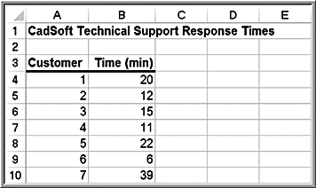
Example 2: Formulating a One-Sample Test of Hypothesis
CadSoft receives calls for technical support. In the past, the average response time has been at least 25 minutes. It believes the average response time can be reduced to less than 25 minutes.
If the new information system makes a difference, then, data should be able to confirm that the mean response time is less than 25 minutes; this defines the alternative hypothesis, H₁.
H₀: mean response time ≥ 25
H₁: mean response time < 25

Slide 9
Understanding Potential Errors in Hypothesis Testing
Hypothesis testing can result in one of four different outcomes:
1. H₀ is true and the test correctly fails to reject H₀
2. H₀ is false and the test correctly rejects H₀
3. H₀ is true and the test incorrectly rejects H₀ (called Type I error)
4. H₀ is false and the test incorrectly fails to reject H₀ (called Type II error)

Slide 10
Terminology
The probability of making a Type I error = α (level of significance) = P(rejecting H₀ | H₀ is true)
The value of 1 – α is called the confidence coefficient
= P(not rejecting H₀ | H₀ is true),
The value of α can be controlled. Common values are 0.01, 0.05, or 0.10.
The probability of making a Type II error = β = P(not rejecting H₀ | H₀ is false)
The value of 1 - β is called the power of the test
= P(rejecting H₀ | H₀ is false).
The value of β cannot be specified in advance and depends on the value of the (unknown) population parameter.

Slide 11
Example 3: How β Depends on the True Population Mean
In the CadSoft example:
H₀: mean response time ≥ 25
H₁: mean response time < 25
If the true mean is 15, then the sample mean will most likely be less than 25, leading us to reject H₀.
If the true mean is 24, then the sample mean may or may not be less than 25, and we would have a higher chance of failing to reject H₀.

Slide 12
Example 3: How β Depends on the True Population Mean
In the CadSoft example:
H₀: mean response time ≥ 25
H₁: mean response time < 25
If the true mean is 15, then the sample mean will most likely be less than 25, leading us to reject H₀.
If the true mean is 24, then the sample mean may or may not be less than 25, and we would have a higher chance of failing to reject H₀.
The further away the true mean is from the hypothesized value, the smaller the value of β.
Generally, as α decreases, β increases.

Slide 13
Improving the Power of the Test
We would like the power of the test to be high (equivalently, we would like the probability of a Type II error to be low) to allow us to make a valid conclusion.
The power of the test is sensitive to the sample size; small sample sizes generally result in a low value of 1 - β.
The power of the test can be increased by taking larger samples, which enable us to detect small differences between the sample statistics and population parameters with more accuracy.
If you choose a small level of significance, you should try to compensate by having a large sample size.

Slide 14
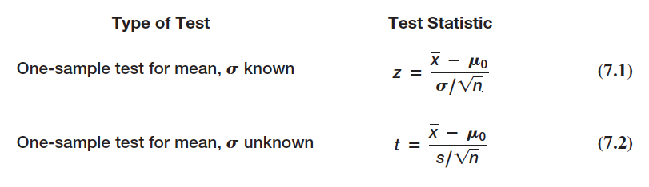


Selecting the Test Statistic
The decision to reject or fail to reject a null hypothesis is based on computing a test statistic from the sample data.
The test statistic used depends on the type of hypothesis test.
Test statistics for one-sample hypothesis tests for means:

Slide 15
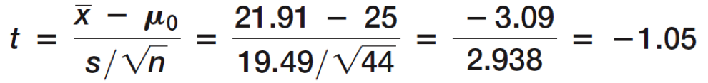
Example 4 Computing the Test Statistic
In the CadSoft example, sample data for 44 customers revealed a mean response time of 21.91 minutes and a sample standard deviation of 19.49 minutes.
t = -1.05 indicates that the sample mean of 21.91 is 1.05 standard errors below the hypothesized mean of 25 minutes.

Slide 16
Drawing a Conclusion
The conclusion to reject or fail to reject H₀ is based on comparing the value of the test statistic to a “critical value” from the sampling distribution of the test statistic when the null hypothesis is true and the chosen level of significance, α.
The sampling distribution of the test statistic is usually the normal distribution, t-distribution, or some other well-known distribution.
The critical value divides the sampling distribution into two parts, a rejection region and a non-rejection region. If the test statistic falls into the rejection region, we reject the null hypothesis; otherwise, we fail to reject it.

Slide 17
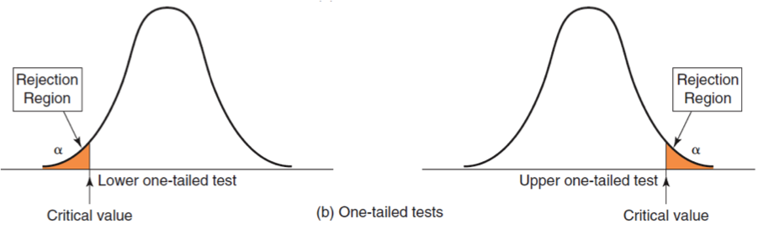
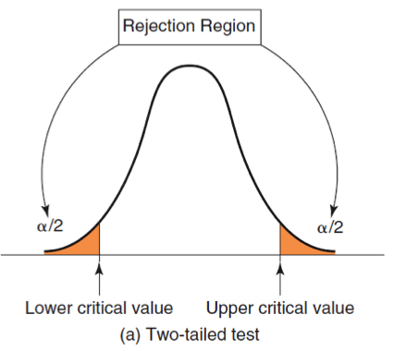
Rejection Regions
H₀: parameter ≥ constant
H₁: parameter < constant
H₀: parameter ≤ constant
H₁: parameter > constant
H₀: parameter = constant
H₁: parameter ≠ constant
For a one-tailed test, if H₁ is stated as <, the rejection region is in the lower tail; if H₁ is stated as >, the rejection region is in the upper tail (just think of the inequality as an arrow pointing to the proper tail direction).

Slide 18
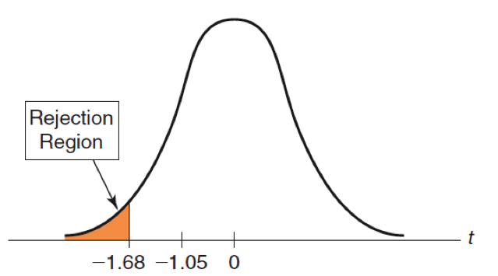
Example 5: Finding the Critical Value and Drawing a Conclusion
In the CadSoft example, use α = 0.05.
H₀: mean response time ≥ 25
H₁: mean response time < 25
n = 44; df = n −1 = 43
t = -1.05
Critical value = t_{α/2, n−1} = T.INV(1− α , n −1) = T.INV(0.95, 43) = 1.68
t = -1.05 does not fall in the rejection region.
Fail to reject H_{0.}
Even though the sample mean of 21.91 is well below 25, we have too much sampling error to conclude the that the true population mean is less than 25 minutes.

Slide 19
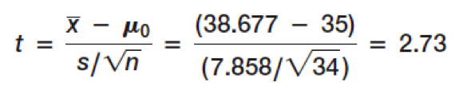
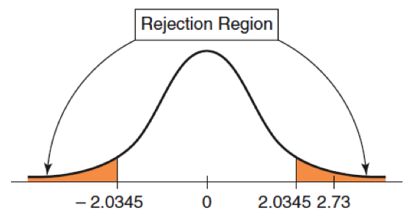
Example 6: Conducting a Two-Tailed Hypothesis Test for the Mean
Excel file Vacation Survey
Test whether the average age of respondents is equal to 35.
H₀: mean age = 35
H₁: mean age ≠ 35
n = 34; sample mean = 38.677; sample standard deviation = 7.858.
Test statistic:
Critical value = T.INV.2T(.05, 33) = 2.0345
p-value = T.DIST.2T(2.69, 33) = 0.0111
Reject H₀.

Slide 20
p-Values
A p-value (observed significance level) is the probability of obtaining a test statistic value equal to or more extreme than that obtained from the sample data when the null hypothesis is true.
An alternative approach to Step 3 of a hypothesis test uses the p-value rather than the critical value:
Reject H₀ if the p-value < α

Slide 21
Finding p-Values
For a lower one-tailed test, the p-value is the probability to the left of the test statistic t in the t-distribution, and is found using the Excel function:
=T.DIST(t, n-1, TRUE).
For an upper one-tailed test, the p-value is the probability to the right of the test statistic t, and is found using the Excel function:
1 - T.DIST(t, n-1, TRUE).
For a two-tailed test, the p-value is found using the Excel function:
T.DIST.2T(t, n-1), if t > 0
T.DIST.2T(-t, n-1), if t < 0

Slide 22
Example 7: Using p-Values
In the CadSoft example, the p-value is the left tail area of the observed test statistic, t = -1.05.
p-value =TDIST(-1.05, 43, true) = 0.1498
Do not reject H₀ because the p-value ≥ α,
i.e., 0.1498 ≥ 0.05
For the Vacation Survey two-tailed hypothesis test in Example 7.6, the p-value for this test is
p-value =T.DIST.2T(2.73,33) = 0.010
Reject H₀ because 0.010 < 0.05

Slide 23
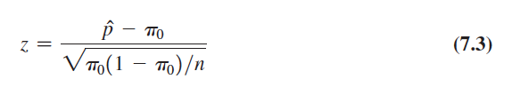

One-Sample Tests for Proportions
Test statistic:
π₀ is the hypothesized value and p is the sample proportion
⌃

Slide 24
Example 8: One-Sample Test for the Proportion
CadSoft sampled 44 customers and asked them to rate the overall quality of a software package. Sample data revealed that 35 respondents (a proportion of 35/44 = 0.795) thought the software was very good or excellent. In the past, this proportion has averaged about 75%. Is there sufficient evidence to conclude that this satisfaction measure has significantly exceeded 75% using a significance level of 0.05?

Slide 25
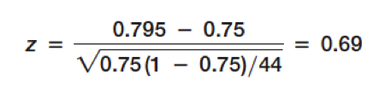
Example 8 Continued
Hypotheses:
H₀: π ≤ 0.75
H₁: π > 0.75
Test statistic:
Critical value = NORM.S.INV(0.95) = 1.645
p-value = 1 − NORM.S.DIST(0.69,TRUE) = 0.24
Do not reject H_{0.}

Slide 26
Two-Sample Hypothesis Tests
Lower-tailed test
H₀: population parameter (1) - population parameter (2) ≥ D₀
H1: population parameter (1) - population parameter (2) < D₀
This test seeks evidence that the difference between population parameter (1) and population parameter (2) is less than some value, D₀.
When D₀ = 0, the test simply seeks to conclude whether population parameter (1) is smaller than population parameter (2).

Slide 27
Two-Sample Hypothesis Tests
Upper-tailed test
H₀: population parameter (1) - population parameter (2) ≤ D₀
H1: population parameter (1) - population parameter (2) > D₀
This test seeks evidence that the difference between population parameter (1) and population parameter (2) is greater than some value, D₀.
When D₀ = 0, the test simply seeks to conclude whether population parameter (1) is larger than population parameter (2).

Slide 28
Two-Sample Hypothesis Tests
Two-tailed test
H₀: population parameter (1) - population parameter (2) = D₀
H1: population parameter (1) - population parameter (2) ≠ D₀
This test seeks evidence that the difference between the population parameters is equal to D₀.
When D₀ = 0, we are seeking evidence that population parameter (1) differs from population parameter (2).
In most applications, D₀ = 0, and we are simply seeking to compare the population parameters.

Slide 29
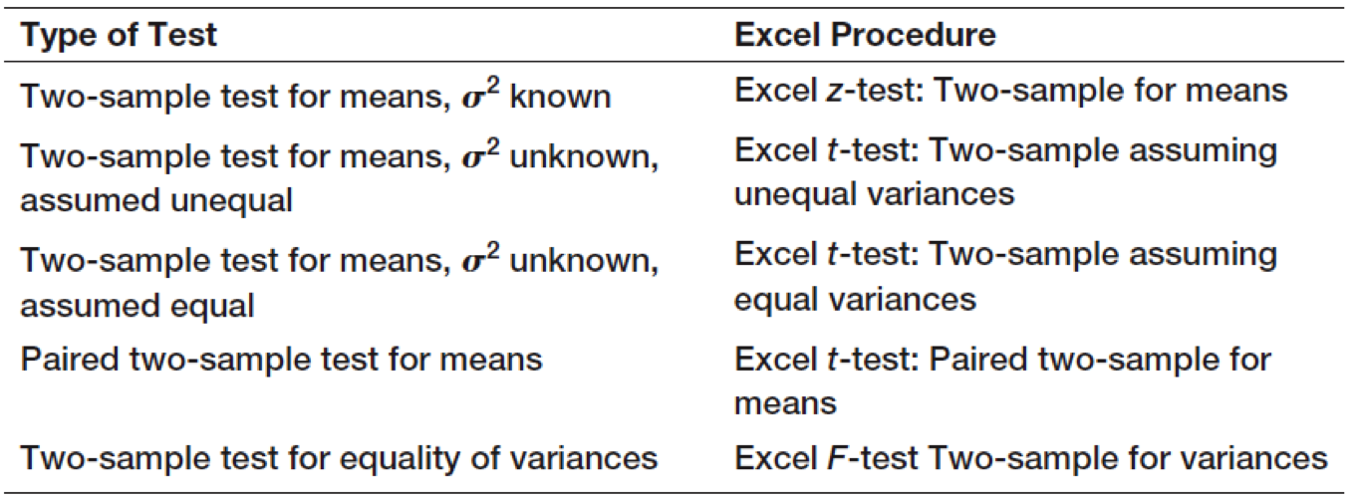
Excel Analysis Toolpak Procedures for Two-Sample Hypothesis Tests

Slide 30
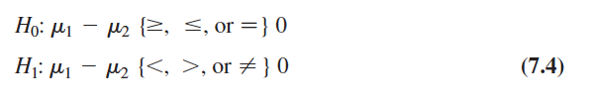

Two-Sample Tests for Difference in Means
Forms of the hypothesis test:

Slide 31
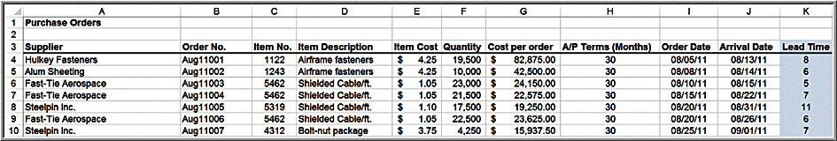
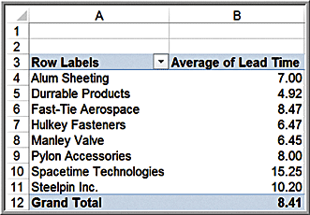
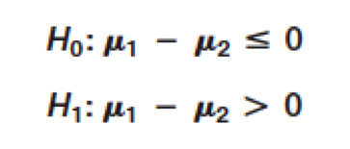
Example 9: Comparing Supplier Performance
Purchase Orders database
Determine if the mean lead time for Alum Sheeting (µ₁) is greater than the mean lead time for Durrable Products (µ₂).

Slide 32
Selecting the Proper Excel Procedure
Population variances are known:
z-Test: Two-Sample for Means
Population variances are unknown and assumed unequal:
t-Test: Two-Sample Assuming Unequal Variances
Population variances are unknown but assumed equal:
t-Test: Two-Sample Assuming Equal Variances
These tools calculate the test statistic, the p-value for both a one-tail and two-tail test, and the critical values for one-tail and two-tail tests.

Slide 33
Intepreting Excel Output
If the test statistic is negative, the one-tailed p-value is the correct p-value for a lower-tail test; however, for an upper-tail test, you must subtract this number from 1.0 to get the correct p-value.
If the test statistic is nonnegative (positive or zero), then the p-value in the output is the correct p-value for an upper-tail test; but for a lower-tail test, you must subtract this number from 1.0 to get the correct p-value.
For a lower-tail test, you must change the sign of the one-tailed critical value.

Slide 34
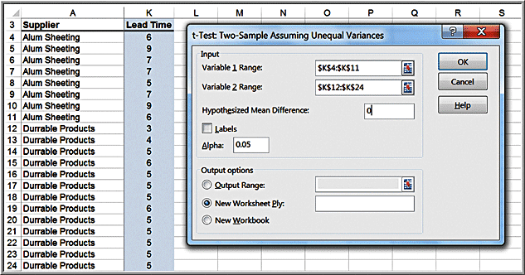
Example 10: Testing the Hypotheses for Supplier Lead-Time Performance
t-Test: Two-Sample Assuming Unequal Variances
Variable 1 Range: Alum Sheeting data
Variable 2 Range: Durrable Products data

Slide 35
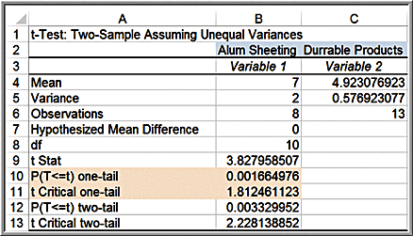
Example 10 Continued
Results
Rule 2: If the test statistic is nonnegative (positive or zero), then the p-value in the output is the correct p-value for an upper-tail test.
t = 3.83
Critical value = 1.81
p-value = 0.00166
Reject H₀.

Slide 36
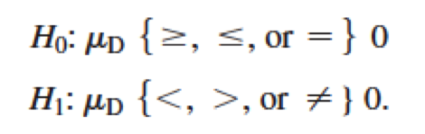
Two-Sample Test for Means with Paired Samples
In many situations, data from two samples are naturally paired or matched.
When paired samples are used, a paired t-test is more accurate than assuming that the data come from independent populations.
Hypotheses (μ_{D} is the mean difference between the paired samples):
Excel Data Analysis tool: t-Test: Paired Two-Sample for Means

Slide 37
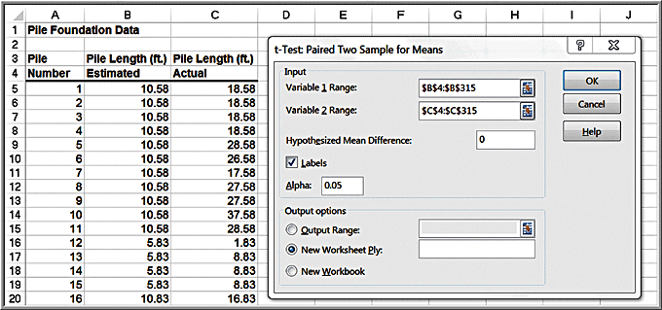
Example 11 Using the Paired Two-Sample Test for Means
Excel file Pile Foundation
Test for a difference in the means of the estimated and actual pile lengths (two-tailed test).

Slide 38
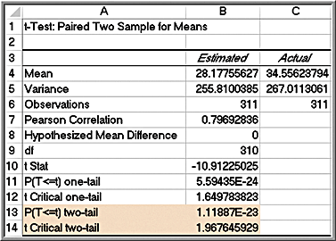
Example 11 Continued
Results:
t = -10.91
t is smaller than the lower critical value
p-value ≈ 0
Reject the null hypothesis

Slide 39




Test for Equality of Variances
Test for equality of variances between two samples using a new type of test, the F-test.
To use this test, we must assume that both samples are drawn from normal populations.
Hypotheses:
F-test statistic:
Excel tool: F-test for Equality of Variances

Slide 40
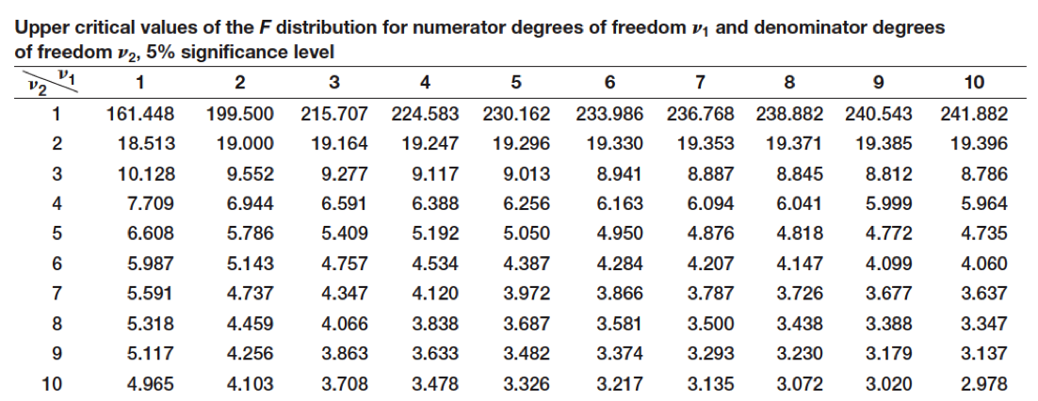
F-Distribution
The F-distribution has two degrees of freedom, one associated with the numerator of the F-statistic, n₁ - 1, and one associated with the denominator of the F-statistic, n₂ - 1.
Table 4, Appendix A provides only upper-tail critical values, and the distribution is not symmetric.

Slide 41
Conducting the F-Test
Although the hypothesis test is really a two-tailed test, we will simplify it as an upper-tailed, one-tailed test to make it easy to use tables of the F-distribution and interpret the results of the Excel tool.
We do this by ensuring that when we compute F, we take the ratio of the larger sample variance to the smaller sample variance.
Find the critical value F_{α/2,df1,df2} of the F-distribution, and then we reject the null hypothesis if the F-test statistic exceeds the critical value.
Note that we are using α/2 to find the critical value, not α. This is because we are using only the upper tail information on which to base our conclusion.

Slide 42
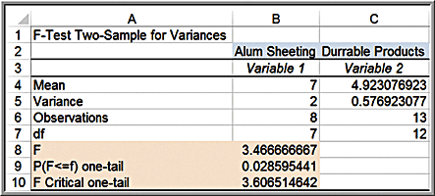
Example 12: Applying the F-Test for Equality of Variances
Determine whether the variance of lead times is the same for Alum Sheeting and Durrable Products in the Purchase Orders data.
The variance of the lead times for Alum Sheeting is larger than the variance for Durable Products, so this is assigned to Variable 1.
F = 3.47
Critical value = 2.91
P-value = 0.029
Reject H₀

Slide 43
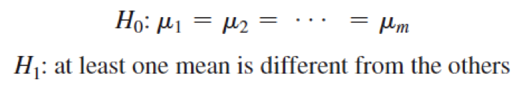
Analysis of Variance (ANOVA)
Used to compare the means of two or more population groups.
ANOVA derives its name from the fact that we are analyzing variances in the data.
ANOVA measures variation between groups relative to variation within groups.
Each of the population groups is assumed to come from a normally distributed population.

Slide 44
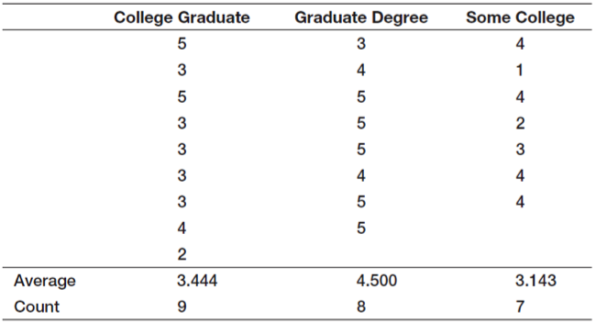
Example 13: Difference in Insurance Survey Data
Determine whether any significant differences exist in satisfaction among individuals with different levels of education.
The variable of interest is called a factor. In this example, the factor is the educational level, and we have three categorical levels of this factor, college graduate, graduate degree, and some college.

Slide 45
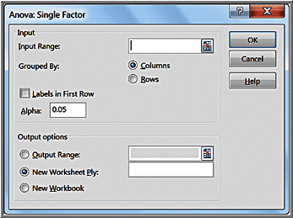
Example 14: Applying the Excel ANOVA Tool
Data Analysis tool: ANOVA: Single Factor
The input range of the data must be in contiguous columns

Slide 46
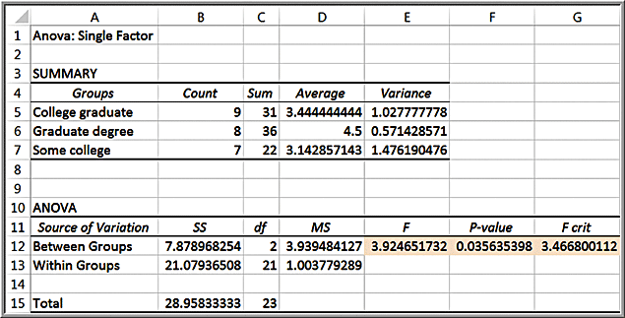
Example 14: Continued
Results
F = 3.92
F_{crit} = 3.46
F > F_{crit}
p-value = 0.0356
Reject H_{0.}

Slide 47
Assumptions of ANOVA
The m groups or factor levels being studied represent populations whose outcome measures
1. are randomly and independently obtained,
2. are normally distributed, and
3. have equal variances.
If these assumptions are violated, then the level of significance and the power of the test can be affected.

Slide 48
Chi-Square Test for Independence
Test for independence of two categorical variables.
H₀: two categorical variables are independent
H₁: two categorical variables are dependent

Slide 49
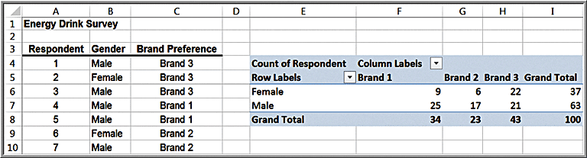
Example 15: Independence and Marketing Strategy
Energy Drink Survey data. A key marketing question is whether the proportion of males who prefer a particular brand is no different from the proportion of females.
If gender and brand preference are indeed independent, we would expect that about the same proportion of the sample of female students would also prefer brand 1.
If they are not independent, then advertising should be targeted differently to males and females, whereas if they are independent, it would not matter.

Slide 50
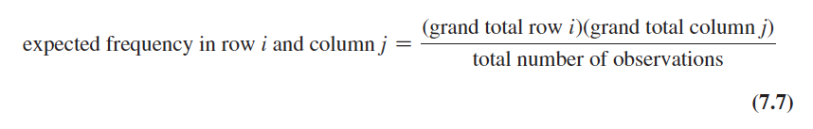

Chi-Square Test Calculations
Step 1: Using a cross-tabulation of the data, compute the expected frequency if the two variables are independent.

Slide 51
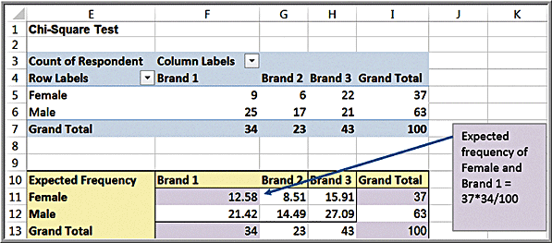

Example 16: Computing Expected Frequencies

Slide 52


Chi-Square Test Calculations
Step 2: Compute a test statistic, called a chi-square statistic, which is the sum of the squares of the differences between observed frequency, f_{o}, and expected frequency, f_{e}, divided by the expected frequency in each cell:

Slide 53
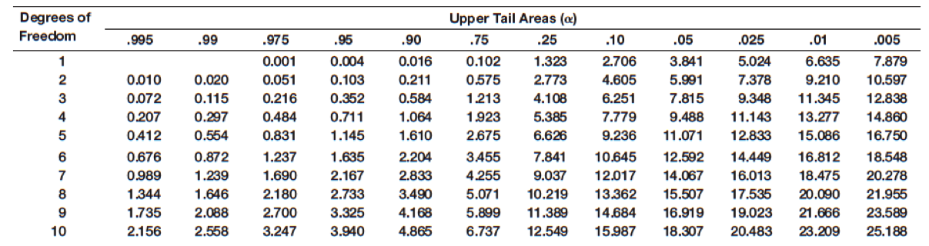
Chi-Square Distribution
The sampling distribution of Χ² is a special distribution called the chi-square distribution.
The chi-square distribution is characterized by degrees of freedom.
Table 3 in Appendix A

Slide 54
Chi-Square Test Calculations (continued)
Step 3: Compare the chi-square statistic for the level of significance α to the critical value from a chi-square distribution with (r – 1)(c – 1) degrees of freedom, where r and c are the number of rows and columns in the cross-tabulation table, respectively.
The Excel function CHISQ.INV.RT(probability, deg_ freedom) returns the value of Χ² that has a right-tail area equal to probability for a specified degree of freedom.
By setting probability equal to the level of significance, we can obtain the critical value for the hypothesis test.
The Excel function CHISQ.TEST(actual_range, expected_range) computes the p-value for the chi-square test.

Slide 55
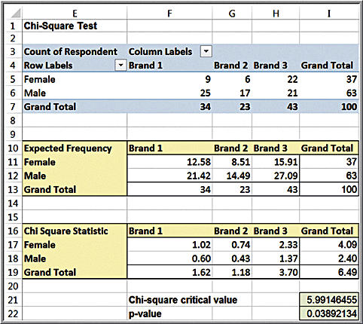
Example 17: Conducting the Chi-Square Test
Test statistic = 6.49
d.f. = (2 – 1)(3 – 1) = 2
Critical value = CHISQ.INV.RT(0.05,2) = 5.99
p-value = CHISQ.TEST(F6:H7,F12:H13) = 0.0389
Reject H₀
Test statistic

